Slide 1




Presented by Prajwal Ratnaparkhi Data Analytics | Bank Analytics Project
Data-Driven Insights for Banking Performance & Decision-Making
Tools & Technologies Used

Slide 2






Introduction
Growing Industry Relevance
Real Banking Insights
Data Quality Challenges
Supports Strategic Decision-Making
Scope for Team Contribution
Key Learnings and Outcomes

Slide 3
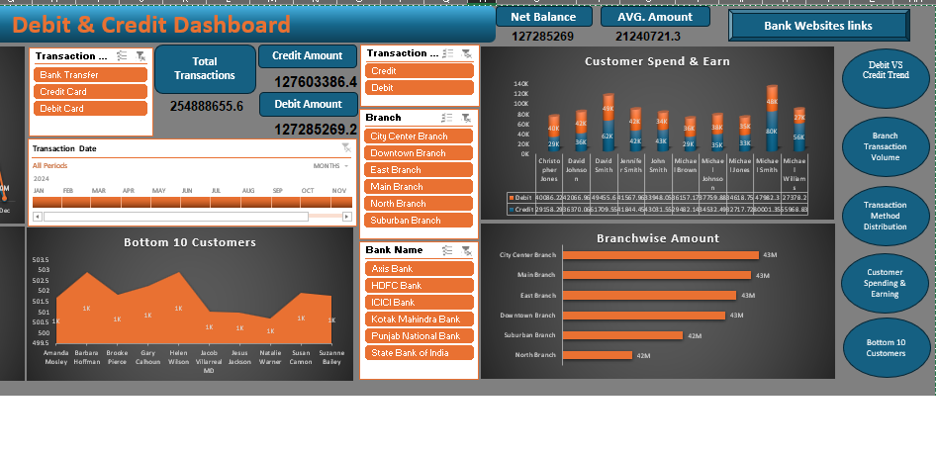

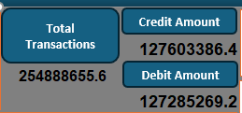
MS Excel
KPI
Insight

Slide 4
Challenge and solution
Challenge
Data label amount converted number into word in KPI
Dynamic values
Solution
searching of the every tool properly
Reference video from different source
Suggestion to Bank
Identify Issue: High Debit Volume but Lower Credit Growth in City Center
Solution: Promote credit cards and pre-approved loans to active debit users.
Issue: High Dependency on Debit Transactions
Solution: Encourage balanced usage by promoting digital banking and credit products.
Issue: Limited Increase in Bank Transfers (14M)
Solution: Promote UPI, mobile banking, automatic payments, and digital awareness programs.

Slide 5
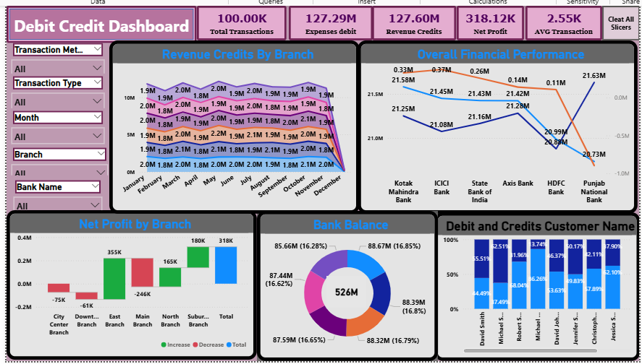
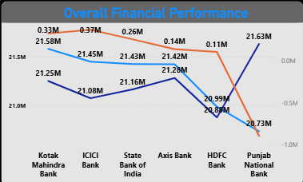
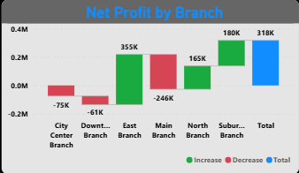
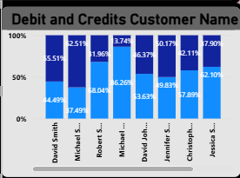
Power BI

Slide 6
Challenge and solution
Challenge
Faced issue to create KPI card dynamic
Solution
Create KPI with the help of create measure in the power BI
Suggestion to Bank
issue : Bank transfer transactions are generating a net loss of –139.85k But the north branch doing good performance to bank transfer transactions why happened : indicating high operational cost or low service charges. Solution : Reduce processing costs, increase small transaction fees, promote digital/UPI channels with lower cost, and optimize backend operations to improve profitability. And use stategy of north branch .
issue : PNB recorded a net loss of –897.17k despite showing good performance in May. Why happened : This happened mainly due to higher operational costs, delayed recoveries, and increased loan defaults. Solution : Strengthen loan recovery and follow-up process.Reduce non-essential operational expenses

Slide 7
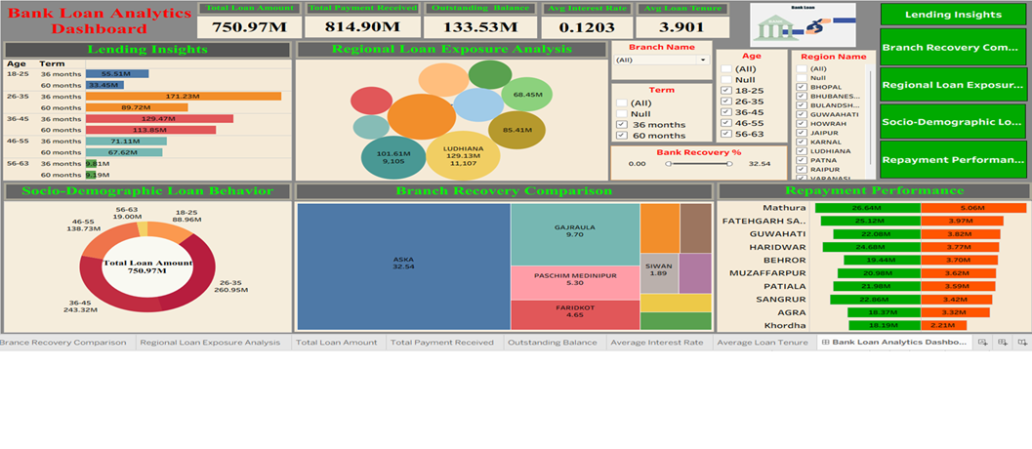
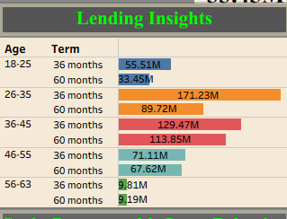
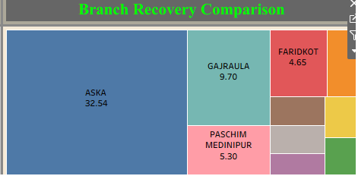
KPI Total Loan Amount Total payment Received outstanding balance Avg Interest Rate

Slide 8
Challenge and solution
Challenge
Show the null value in the dashboard
Solution
Clean data in the power query editor and then remove null value, remove the unwanted column into the dataset
Suggestion to Bank
issue : FARIDKOT (4.65%) and smaller branches have low recovery performanc why happened : 1. Low-performing branches may have higher overdue customers 2. Regional economic conditions may be affecting repayment ability in some areas. Solution : 1. Replicate ASKA’s recovery strategy in low-performing branches 2. Set specific recovery targets for low-performing branches like FARIDKOT
issue : Very low loan volume in ages 56–63, showing weak engagement with older customers.
why happened : Older customers may be risk-averse, avoiding long-term loans.
Solution : Introduce age-specific loan schemes to increase participation of the 56–63 group.

Slide 9
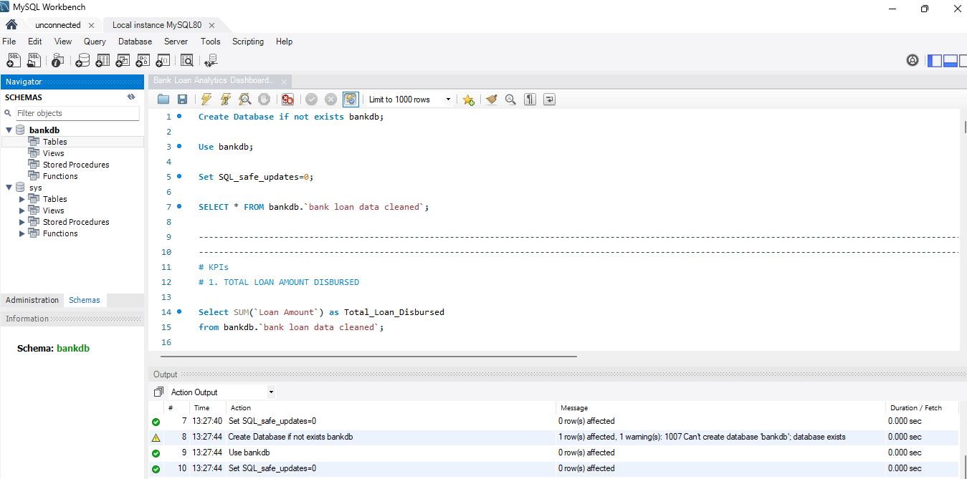
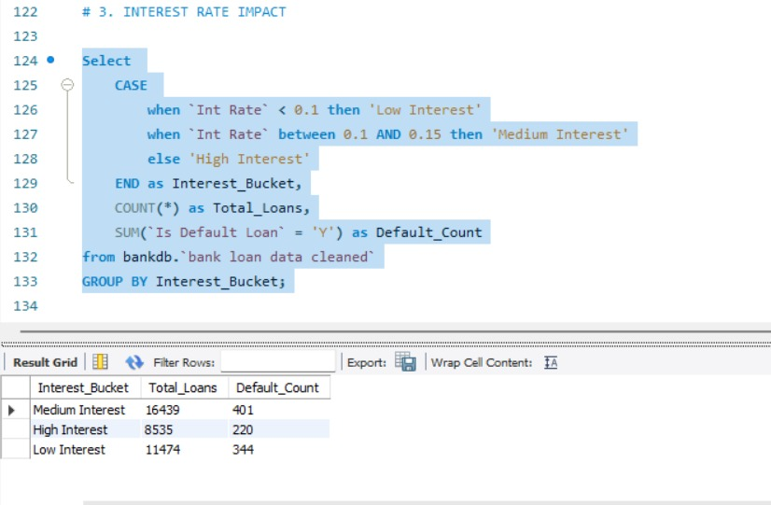
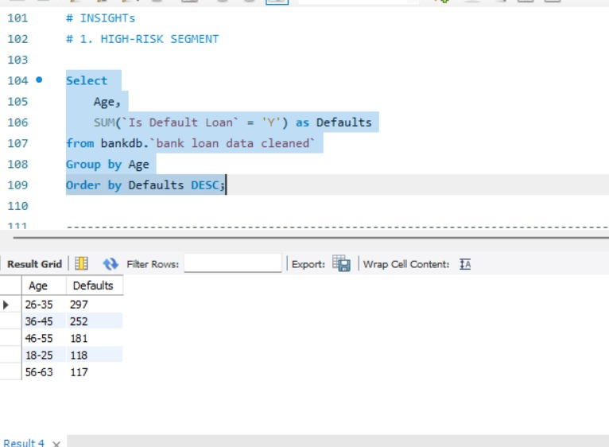
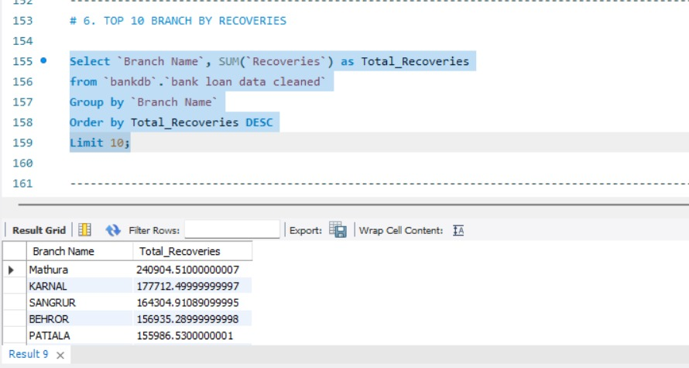
MYSQL
1st Insight
3rd Insight
2nd Insight

Slide 10
Challenge and solution
Challenge
Cleaned the data using the python and loading data issues
Solution
Used clean excel file in csv format and loaded the data in MYSQL
Suggestion to Bank
issue : here 1st insight the defaulter is belong from high interest bucket.
why happened : 1. due to high interest rate Solution : 1. strive to provide to loan in low interest rate
issue : here 2nd insight the lowest recovery is the Patiala
why happened : Regional economic conditions may be affecting repayment ability in some areas.
Solution : Strengthen follow-up & customer communication (SMS, calls, field visits).

Slide 11
Thank You…
Open to feedback and insights that can help me improve further….

